Slide 1
Graphics Introduction Jian Zhao 2013/12/26

Slide 2
Agenda
Graphics in Our Daily Life
What is GPU
Basic 3D Pipeline
Qualcomm Adreno Generation
Android Graphics Integration

Slide 3
Graphics in Our Daily Life
What can we do with GPU?
What can we do with GPU in future?

Slide 4
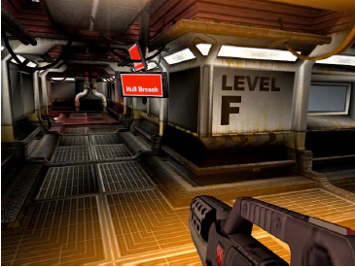
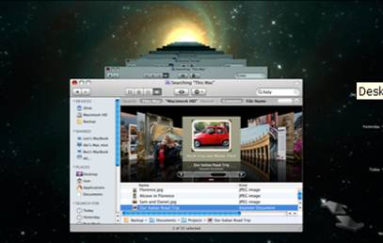

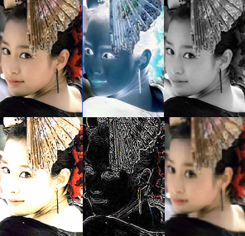
What we can do with GPU?
3D Games
3D/Composite UI
3D Modeling
Image/Video Processing

Slide 5
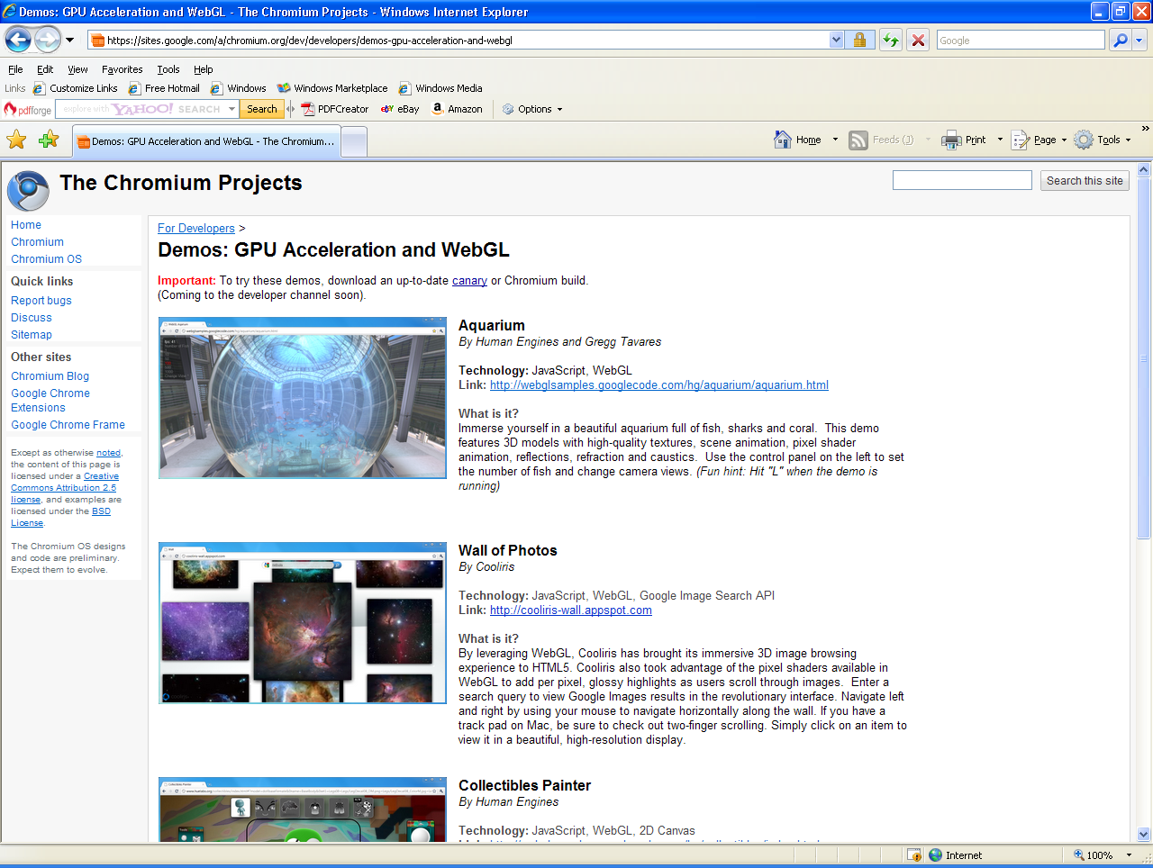
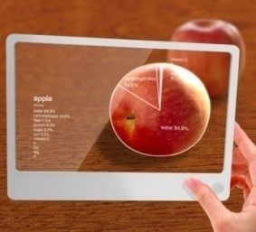
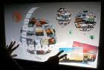
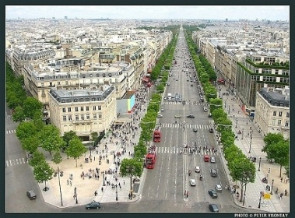
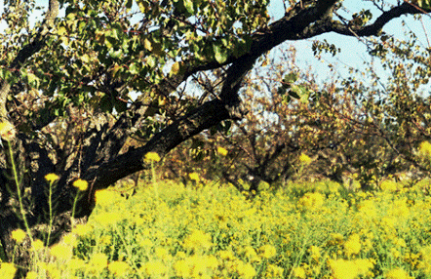
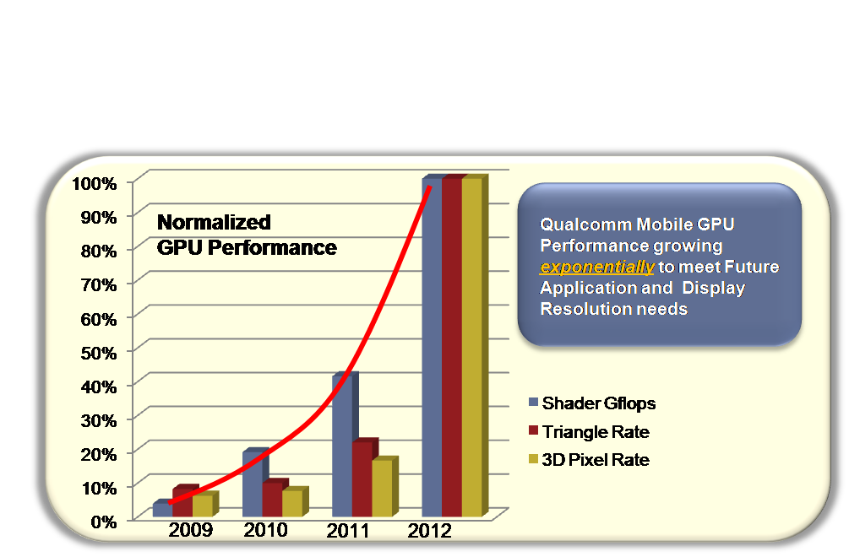


What we can do with GPU in future?
3D Web Pages
Augmented Reality
3D User Interfaces
Mobile Navigation
3D Video/Imaging
Console Quality
3D Games
Data Mining/Analytics
Notes:
HTC Sense UI

Slide 6
What Is GPU?
What are running on GPU?
What does GPU driver do?
Why GPU is faster?

Slide 7


Graphics Acceleration in Qualcomm Chipsets
MODEM
CPU(s)
GPU
Multimedia
GPS, WiFi
Etc.

Slide 8
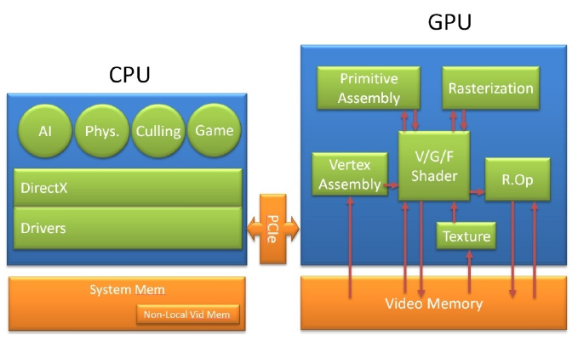
What Are Running on GPU?
*The graph is cut from NV programing guide.

Slide 9
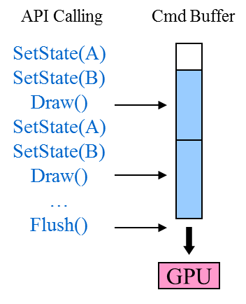
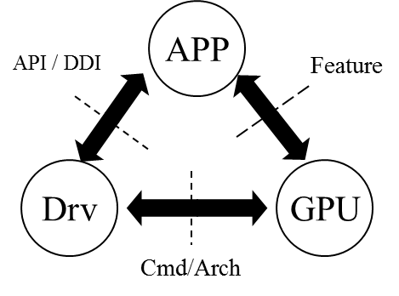
What Does GPU Driver Do?
API Translation
Correctness
Efficiency
Shader Compiler
Scheduling and load balance
Resource scheduling
Load balance
CPU and GPU
Multi-CPU and Multi-GPU
Workaround for HW limitation or bug
Driver Model
User mode driver: Receive application input
Kernel mode driver: Access hardware; Global scheduler

Slide 10
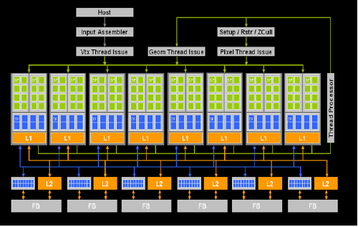
Why GPU Is Faster ?
Execution of different stages can be parallel by different HW units
SIMD procession
Internal multi-thread to boost performance
Many ALUs to support many threads to run on parallel
Hide memory access latency and pipeline stall
High bandwidth memory system
Parallelism!
Parallelism!
Parallelism!
 | GFLOPS | BW(GB)
9600GT (64 Sp) | 312 | 57.6
GTX 280 (240 sp) | 933 | 142

Slide 11
Basic 3D Pipeline
How does a basic 3D pipeline look like?
How GPU works?

Slide 12

3D Pipeline Overview
GPU
CPU/
Driver
Vertex Setup
Vertex Shader
Rasterizer
Pixel Shader
Frame buffer
Texture Storage + Filtering
Vertices
Pixels

Slide 13
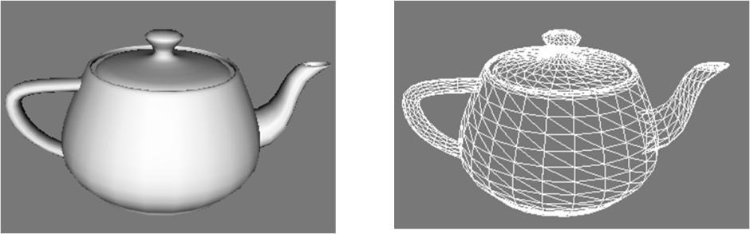
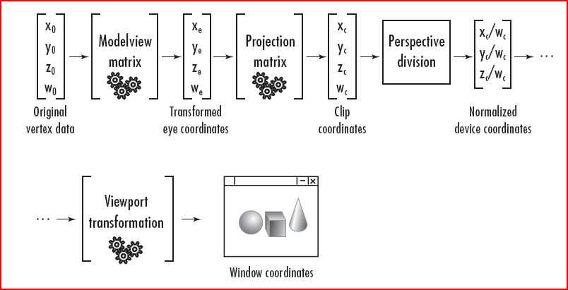
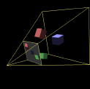
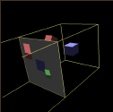
How Does GPU Draw and Paint?
Modeling
Use triangles as the basic brick for all geometries.
Transformation

Slide 14
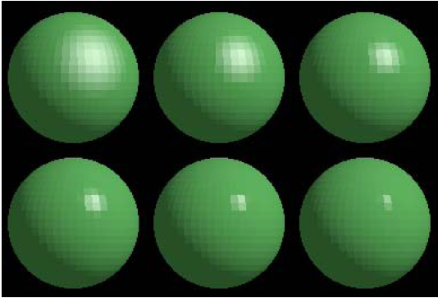
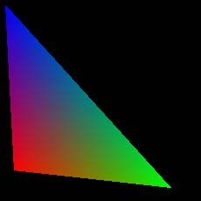
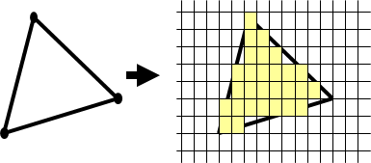
How Does GPU Draw and Paint? (cont)
Lighting
Vertices lit (shaded) according to material properties, surface properties (normal) and light sources
Ambient, Diffuse, Specular, Emissive.
Rasterization
blue
red
green

Slide 15
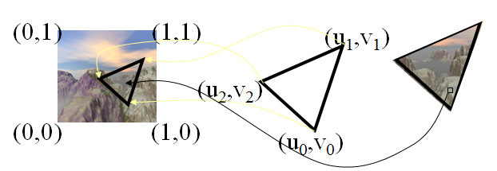
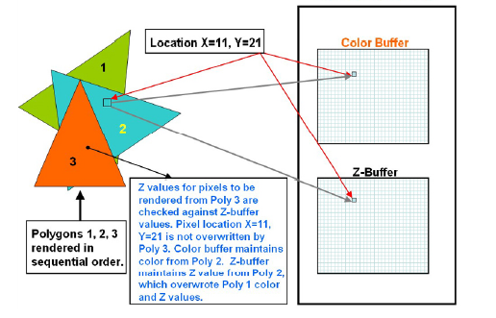
How Does GPU Draw and Paint? (cont)
Texture
Depth Test

Slide 16
Quiz ☺
How many data do we need for a vertex point?
Position: x, y, z, w
Color: r, g, b, a
Texture Coordinate: u, v
Normal: x, y, z (for lighting, reflection, etc.)
……

Slide 17
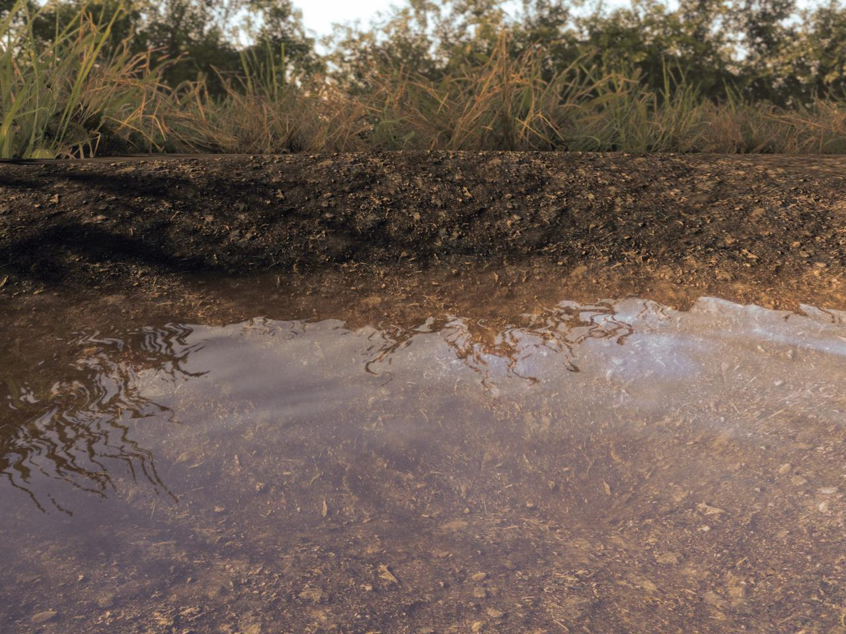
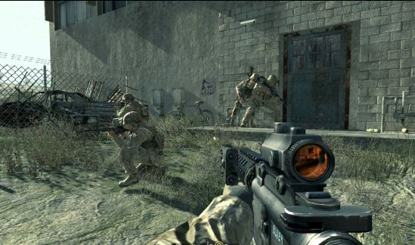
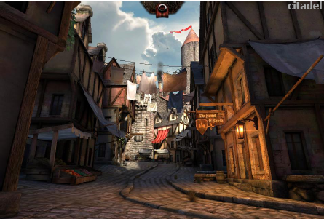
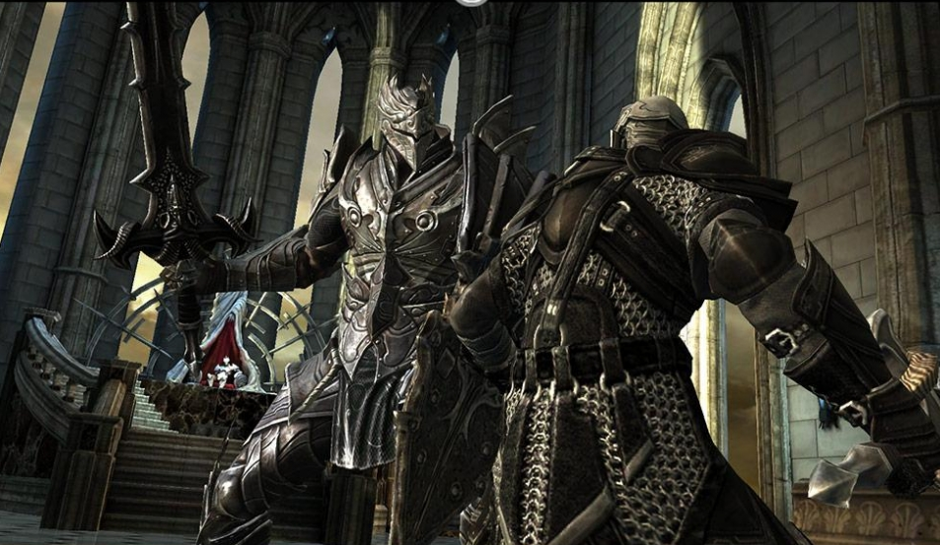
Game Snapshots

Slide 18
Qualcomm Adreno Generation
Adreno generation and capability
Adreno 3xx HW

Slide 19
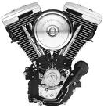
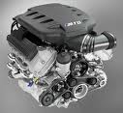
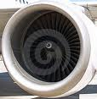
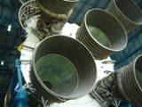
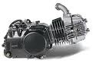
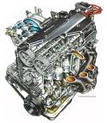
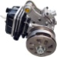
Qualcomm Adreno Generation
ADRENO 220/5
ADRENO 320
ADRENO 420
ADRENO 520
Motorcycle Engine
V8 Car Engine
Airplane Jet Engine
Rocket Engine
ADRENO 205
ADRENO 410
ADRENO 510
ADRENO 305
ADRENO 4-Lite
ADRENO 5-Lite
Dirt bike Engine
4 Cylinder Car Engine
GPU Requirements will continue to Exponentially Increase over the next 5 years
ADRENO 200
Moped Engine

Slide 20
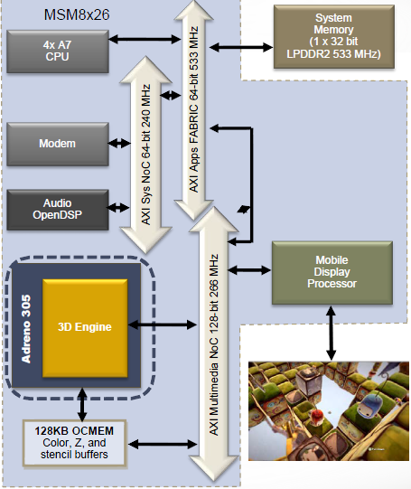
Adreno 3xx GPU
Adreno™ 305 GPU (450 MHz)
Same amount of ALUs as on Adreno 320
On-Chip Memory (OCMEM) For graphics, 128 KB(512K for 8x30) for fast Z, color, and stencil rendering
No 2D hardware core (8x30) but still has C2D
8x26:
Adreno305,3D core 400MHz OpenGLES1.1 - 3.0 OpenCL1.1e
Direct3D 9.3
EGL 1.4
8x25:
Adreno203, 3D core 245MHz
OpenGLES1.1 - 2.0
Direct3D 9.0c
EGL 1.4

Slide 21
Adreno 3xx GPU(cont)
400MHz
2D
Application
3D Application
OGL
VTX
OCL
Work Groups
TP: Texture Pipe
Scheduler
Scalable “SP” Unit for A3XX Tiers
Thread
Post TransformVertex Cache
Shader Processor
Texture
TP
L1 Cache
Texture data
Unified L2 Cache
Texture
TP
Vertex
Pixel
External Memory
Pixel
Render Backend
Color & Z
Shader Processor
Texture
TP
L1 Cache
Texture data
Texture
TP
Vertex
Pixel
Pixel
Render Backend
Color & Z
Shader Processor
Texture
TP
L1 Cache
Texture data
Texture
TP
Vertex
Pixel
Pixel
Render Backend
Color & Z
Shader Processor
Texture
TP
L1 Cache
Texture data
Texture
TP
Vertex
Pixel
Pixel
Render Backend
GMEM
Color & Z
Notes:
How many ALUs in a SP? simd32 (* 16 dbouble(32))

Slide 22
Android Graphics Integration
Android Graphics stack
Adreno Graphics Driver Architecture
Adreno features overview
How to composite windows?

Slide 23
Android Graphics Stack
Graphics Application
Java level OES/EGL Wrapper
Java Level
User Space
Native Level
Surface Flinger
EGL Wrapper
(libEGL.so)
Graphics Driver
(OpenGL ES)
Google
Kernel Space
Frame Buffer
ION (PMEM/ASHME)M)
KGSL
(Kernel module)
OEM\3rdParty
Qualcomm
Hardware
MDP
GPU

Slide 24
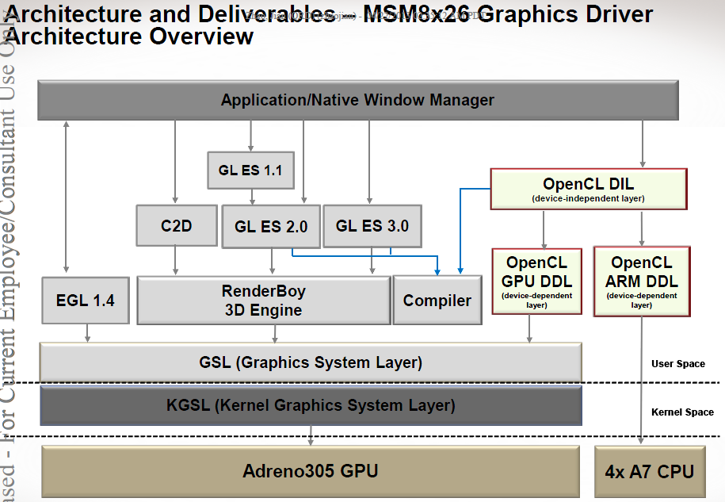
Adreno Graphics Driver Architecture

Slide 25
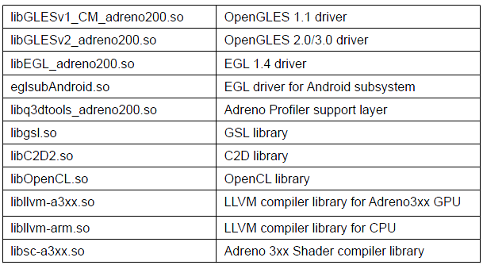
Adreno Graphics Drivers
User mode drivers:
Kernel mode drivers:
Kernel Graphics System Layer(KGSL) driver
Kernel/drivers/gpu/msm/

Slide 26
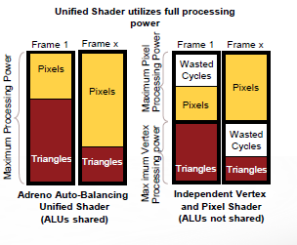
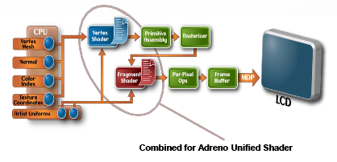
Adreno Features overview
Unified shader architecture increases efficiency of vertex and pixel shaders High degree of latency hiding with FIFOs and multithreading
▪Sophisticated shader support Support for branched shaders
Support for up to 16 textures in a single pass
▪Early rejection of nonvisible data for efficiency and performance Back-facing triangles removed before attribute processing
Hidden pixels removed before texture fetch and pixel processing
▪Extensive frame buffer format coverage 16 and 24-bit Z with 8-bit stencil
16 and 32-bit color
RGBA, ABGR color ordering
▪Wide range of texture formats supported 16/32-bit,
compressed (ATITC and DXTC, ETC1, S3TC),
NV21_Adreno and V12_Tiled
Note: S3TC/DXTC not enabled due to license issue.
Nonpower-of-two (NPoT) sizes supported

Slide 27
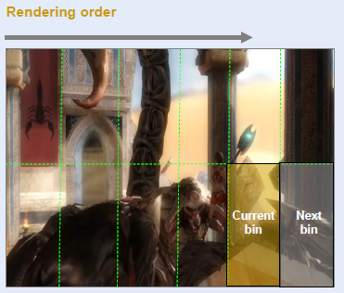
Adreno features overview (cont.)
Adreno binning architecture
Eliminates unnecessary data traffic to host memory
Improves rendering performance, especially for games, UI, and web applications
Minimizes power consumption
▪Rendering surface split up into bins Binning creates visibility streams for each triangle
Rendering pass uses visibility streams to draw only pixels that are visible; does not waste GPU cycles and power drawing occluded pixels
Once all pixels for each bin are drawn to an internal tile buffer called GMEM, the GPU efficiently burst writes all pixels to the frame buffer in system memory

Slide 28
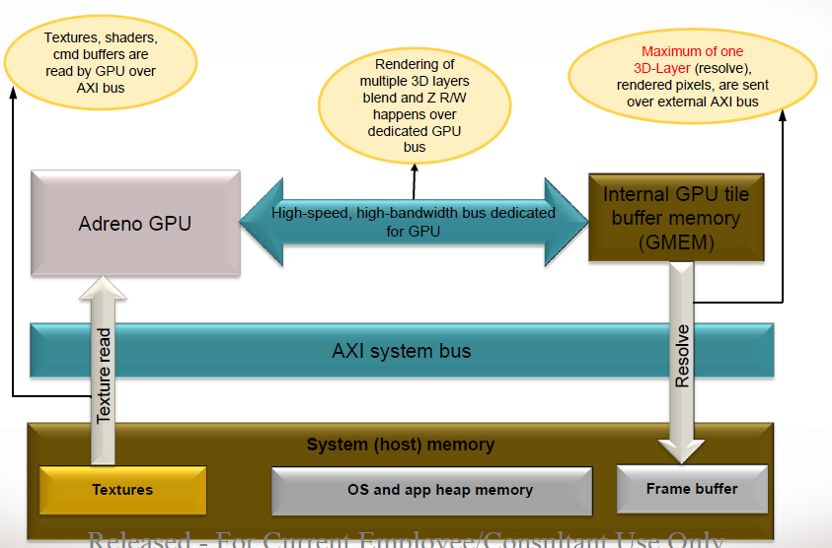
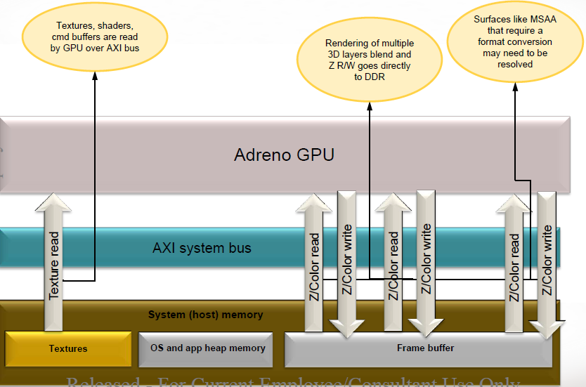

Slide 29
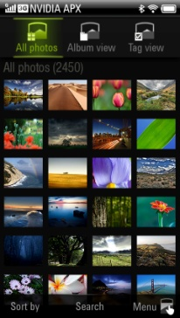
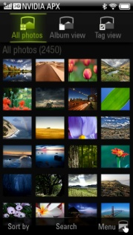

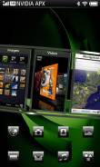
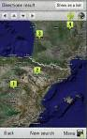

Windows Composition
Multiple off-screen surfaces are composited to the screen using OpenGL ES for flexible screen layout and transitions
Composition based window system
Multiple application processes render into off-screen, cross-process texture surfaces
Native OS Window Manager or a Launcher application creating a custom UI experience
Application
Application
Compositor
Application

Slide 30
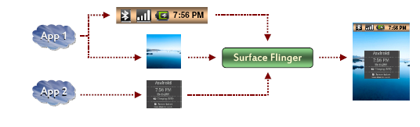
Android Display System: Surface Flinger (HW Composer)
Surface Flinger
Surface*
App
Overlay Buffer
Surface*
HW Composer
LCD
App
Surface
GPU
Frame Buffer
Surface
Basic Working Flow
SurfaceFlinger passes all layers to HW Composer
HW Composer decides to handle all or part of them, by marking OVERLAY flag.
Left layers, marked with FB flag, will be handled by SurfaceFlinger.
HW Composer can let Surfaceflinger clear OVERLAY layers corresponding areas for final composition.

Slide 31
Some settings in debugging graphics issues
Setprop debug.egl.hw 0 ; force sw rendering
Setprop debug.sf.hw 0
Setprop debug.composition.type gpu/mdp/c2d/(sw)
Setprop debug.gr.swapinterval 0
Setprop debug.gr.calcfps 1
ls /sys/devices/platform/kgsl-3d0.0/kgsl/kgsl-3d0/

Slide 32
Q/A
Thank you!

Slide 33
Back-up Pages

Slide 34

Khronos Group

Slide 35














Khronos Standards
3D Authoring
Embedded Media Application APIs
3D Asset Interchange Format
Open Standard Effects Framework
Vector 2D
Safety Critical 3D
Cross platform desktop 3D
Embedded 3D
Surface and synch abstraction
3D APIs
Streaming Media
Audio
Umbrella specification – EGL-based graphics and media stack
Umbrella specification – OpenKOGS plus OS portability
CODEC and media component portability
Streaming Media System Integration
Cross platform APIs for window systems
System Integration APIs

Slide 36
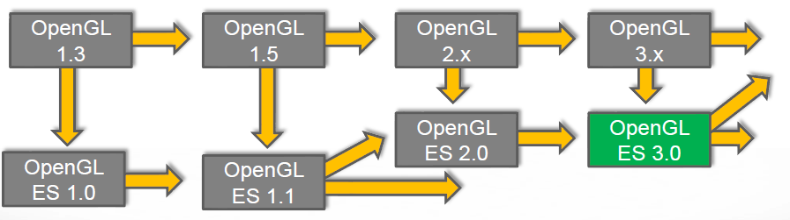
OpenGL/GLES evolvement

Slide 37
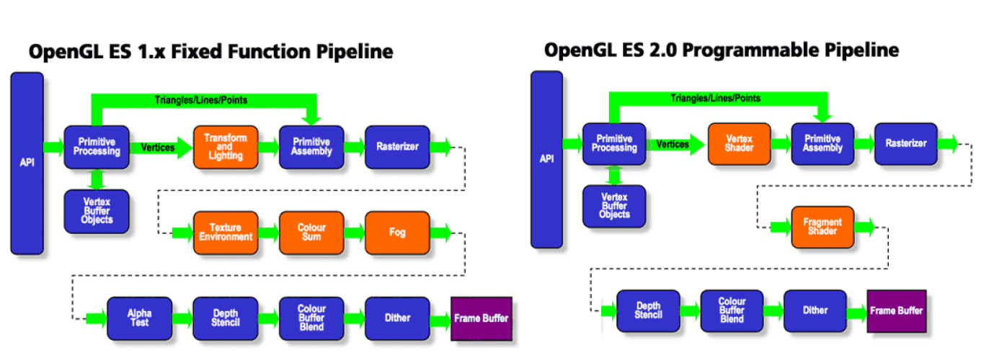
OpenGL ES 1.1/2.0 and 3.0
OpenGL ES 3.0 new features :
Transform Feedback, but no Geometry Shader
Draw Instance, MRT and Occlusion query
Pixel Buffer Object, Uniform Buffer Object
More texture formats and sampler type
New universal compression format ETC2 and ASTC

Slide 38
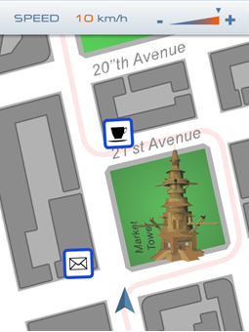
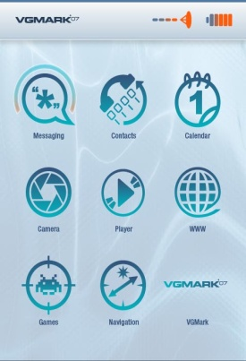





Vector Graphics and OpenVG
Standard & API
OpenVG, SVG, HTML5 Canvas …
Skia, Cairo, Direct2D …
Target applications
UI, Browser, Printing, Image Procession …

Slide 39






EGL and OpenKODE
EGL
Encapsualte the difference of different native window system.
Unified API for context and surface creation and binding
Cross API integration, resource sharing and synchronization
OpenKODE
Core OS abstraction
Main() and Exit()
Window and Event procession
IO operations (file, format, socket, …)
Thread and Synchronization
Math
Source code portability
Native Applications (e.g. Browsers, Games, Navigation, Media)
UI/Widget Toolkits
3D Gaming Engines
Flash/SVG/Font Engines
TV/Video/Audio Engines
Embedded 3D
Vector 2D
Streaming Media
Audio
Surfaces and synch
Graphics stack umbrella spec – defines media API and EGL to be present and tests trans-API interoperability
Source portability umbrella specification – adds OpenKODE Core OS abstraction API

Slide 40



OpenCL
OpenCL – Open Computing Language Open, royalty-free standard for programming heterogeneous parallel computing at the intersection of GPU and multi-core CPU capabilities

Slide 41




WebGL and WebCL
WebGL
API based on OpenGL ES
Accessed via JavaScript
Exposed through HTML5 Canvas
WebCL
Enable high performance parallel processing on GPU/multicore in web app
Integrate OpenCL capabilities in JavaScript
Design with security

Slide 42


Stream Input & Computer Vision

